Slide 1
MALLA REDDY UNIVERSITY
MR22-1CS0141:
DESIGN AND ANALYSIS OF ALGORITHMS
II YEAR B.TECH. (CSE) / I - SEM
(MRU - R22)
UNIT - V

Slide 2
UNIT- V
Branch and Bound:
General method of Branch and Bound , Applications of Branch and Bound- Travelling sales person problem, 0/1 Knapsack problem-LC branch and Bound solution(LCBB).
NP-Hard and NP-Complete Problems:
Basic concepts, P- class and NP- class problems, Deterministic and Non deterministic algorithms, NP-Hard and NP-Complete classes, NP-Hard problems.

Slide 3
Branch and Bound
Branch and bound is one of the techniques used for problem solving.
It is similar to the backtracking since it also uses the state space tree.
But it follows Breadth First Search instead of Depth First Search.
It is used for solving the optimization problems and minimization problems.
If we have given a maximization problem then we can convert it using the Branch and bound technique.

Slide 4
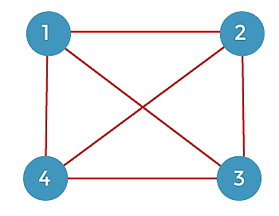
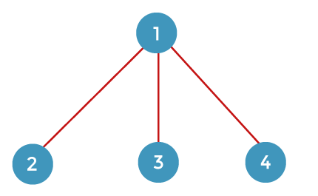
Branch and Bound - Example
Let's first understand the approach then we solve the above problem.
The graph is given below, which has four vertices:
we make a state space tree.
From the starting vertex 1,
we can go to either vertices 2, 3, or 4

Slide 5
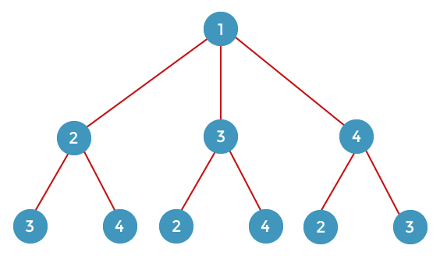
Branch and Bound - Example
From vertex 2, we can go either to vertex 3 or 4.
From vertex 3, we can go either to vertex 2 or 4.
From vertex 4, we can go either to vertex 2 or 3.

Slide 6
Branch and Bound - Example
From vertex 3, we can go to vertex 4.
From vertex 4, we can go to vertex 3.
From vertex 2, we can go to vertex 4.
From vertex 4, we can go to vertex 2.
From vertex 2, we can go to vertex 3.
From vertex 3, we can go to vertex 2.
1
2
3
4
3
4
2
4
2
3
4
3
4
2
3
2

Slide 7
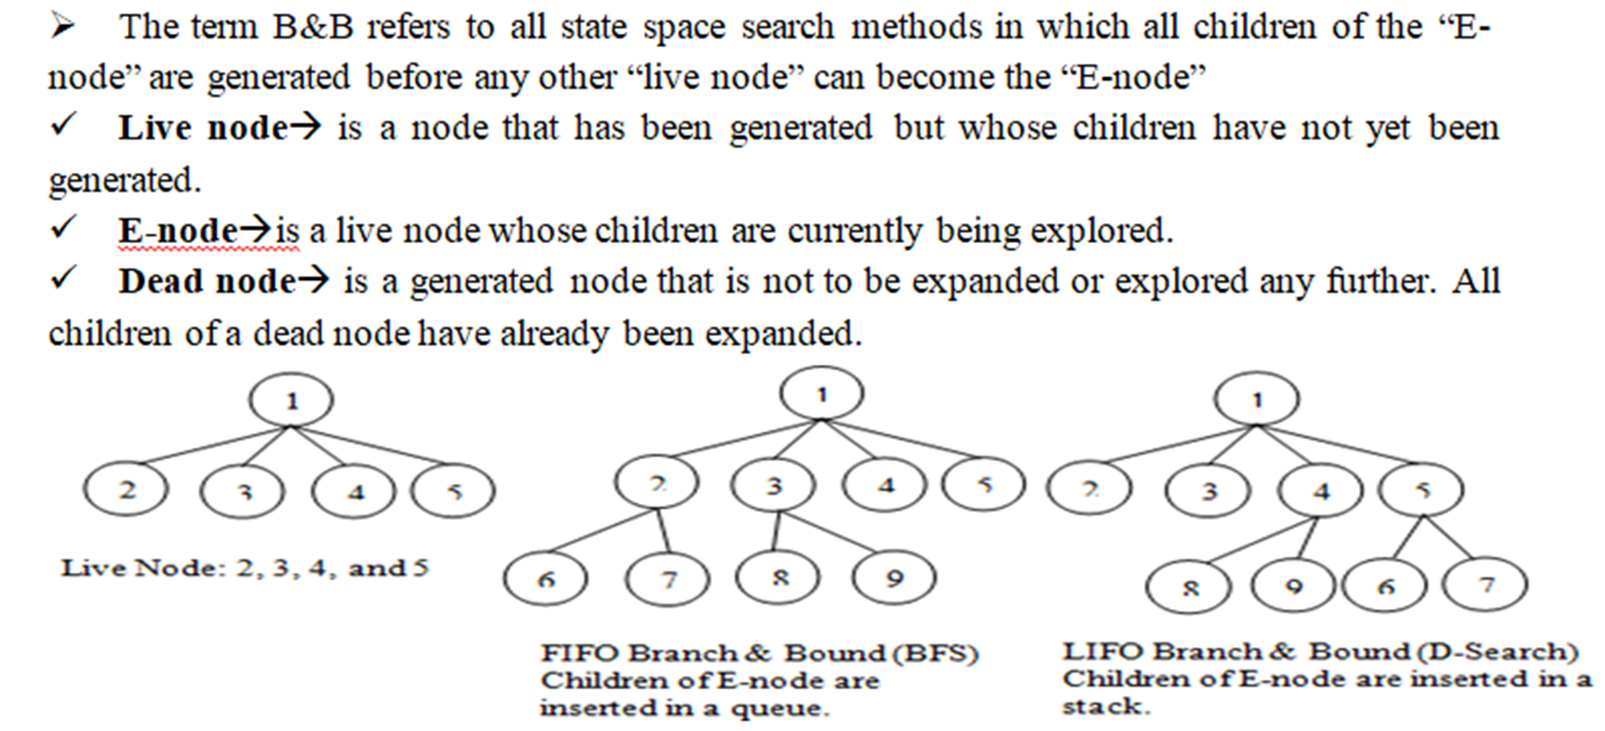
Branch and Bound - Example

Slide 8
Branch and Bound
Three types of Branch and Bound,
1. FIFO (Queue)
2. LIFO (Stack)
3. LC bound (Lowest cost)
Example:
C=2
1
1
1
C=2
C=4
C=5
2
3
4
2
3
4
2
3
4
C=3
C=5
4
FIFO
(Queue)
2
4
3
LC Bound
3
LIFO
(Stack)
3
C=4
3
4
3
2
4

Slide 9
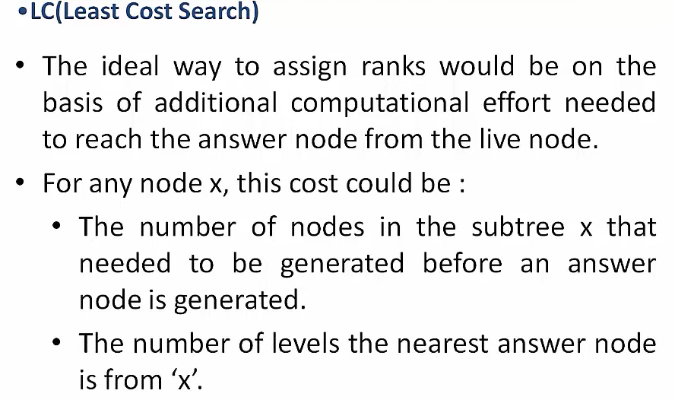
Branch and Bound

Slide 10
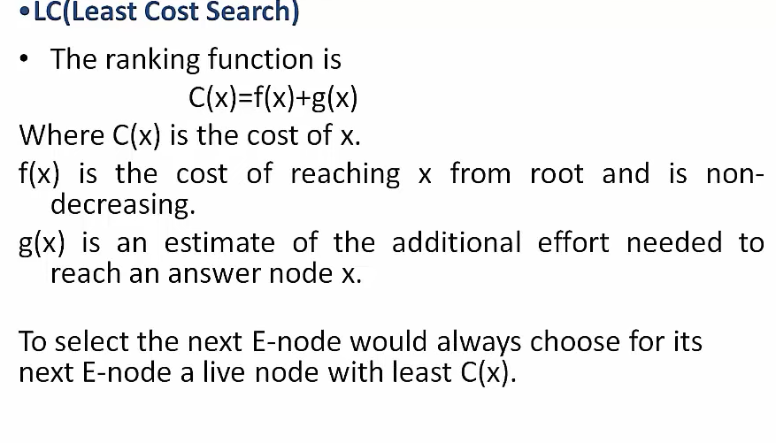
Branch and Bound

Slide 11
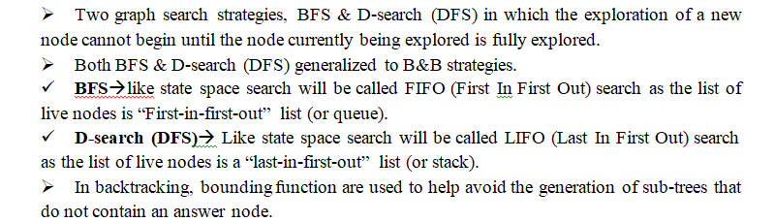
Branch and Bound - Example

Slide 12

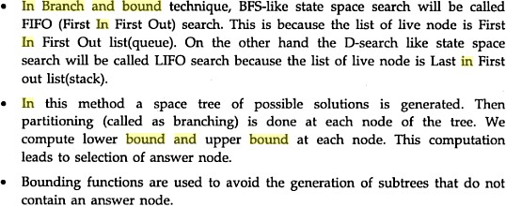
Branch and Bound - Example

Slide 13
Applications
Integer programming
Nonlinear programming
Travelling salesman problem
Quadratic assignment problem (QAP)
Maximum satisfiability problem (MAX-SAT)
Nearest neighbor search
Flow shop scheduling
Cutting stock problem
Computational phylogenetics
Set inversion
Parameter estimation
0/1 knapsack problem
Set cover problem
Feature selection in machine learning
Structured prediction in computer vision
Arc routing problem, including Chinese Postman problem

Slide 14
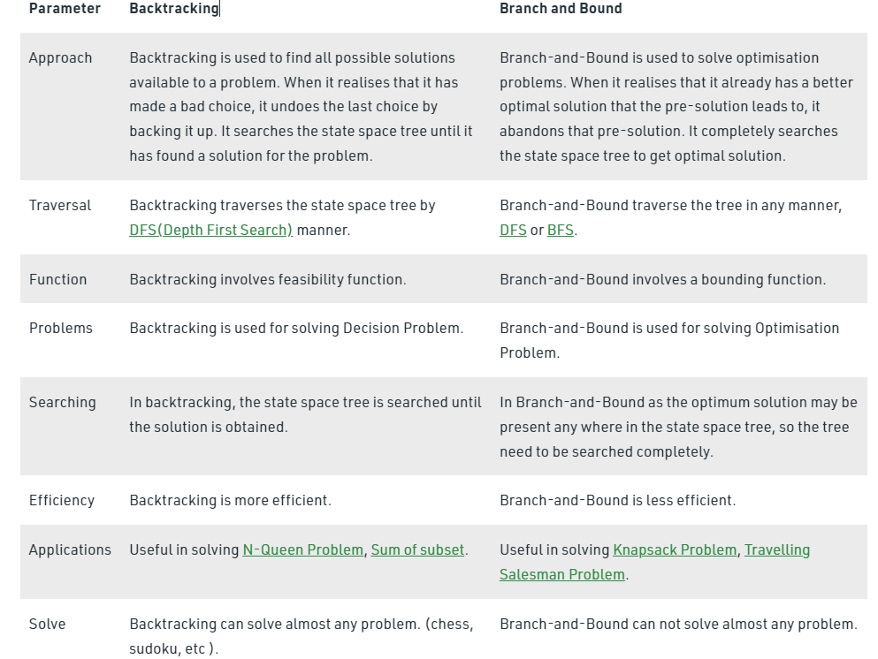
Applications

Slide 15
Travelling sales person problem
Example 1:
Given a set of cities and distance between every pair of cities, the problem is to find the shortest possible tour that visits every city exactly once and returns to the starting point.
The adjacent matrix of the problem is given below:
6
A
B
4
5
4
8
9
D
C
9

Slide 16
Travelling sales person problem
Solution:
Steps to solve:
1. Construct a state space tree by choosing any vertex from the given graph as a starting vertex and find the cost for it by checking whether the matrix is a Reduced Matrix(All row and column should contain at least one value as 0).
2. If the matrix is a reduced Matrix then calculate the cost of that node by using the formula,
c[j] = c[i,j] + c[i] + r where, r is the reduced cost
3. Otherwise, convert the matrix into reduced matrix by subtracting the row and column values with the minimum value respectively.
4. Take the adjacent vertices and find the cost for all.
5. Proceed the traversals by choosing the minimum cost vertices(LC Bound) until the tour completes and reaches the starting point(starting vertex).
6. Initially the upper bound value is

Slide 17

Travelling sales person problem
Solution:
Now the starting vertex is A, and the cost can be calculated as,
Step 1: Row Reduction
Column Reduction
1
C=18
--------------------- > 1
Reduced cost (r)

Slide 18
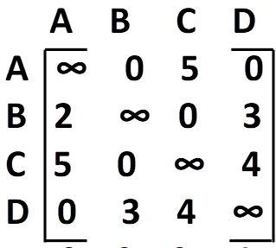
Travelling sales person problem
Step 2: For finding the cost of B, Make A’s Row , B’s Column and [B,A] as ∞ from 1, and check for the Reduced Matrix.
A[ ]=
Find Reduced Matrix,
Row Reduction
1
C=18
A
2
3
4
B
C
D
For finding cost of B,
c[B] = c[A,B] + c[A] + r
= 0 + 18 + 4
=22

Slide 19
Travelling sales person problem
Step 3: For finding the cost of C, Make A’s Row , C’s Column and [C,A] as ∞ from 1, and check for the Reduced Matrix.
A[ ]=
Find Reduced Matrix,
Row Reduction Column Reduction
1
C=18
A
2
3
4
B
C
D
For finding cost of C,
c[C] = c[A,C] + c[A] + r
= 5 + 18 + 3
=26
-------------------------> 3

Slide 20
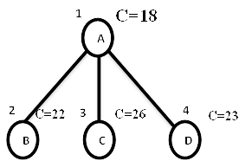
Travelling sales person problem
Step 4: For finding the cost of D, Make A’s Row , D’s Column and [D,A] as ∞ from 1, and check for the Reduced Matrix.
A[ ]=
Find Reduced Matrix,
Row Reduction Column Reduction
For finding cost of D,
c[D] = c[A,D] + c[A] + r
= 0 + 18 + 5
=23
-------------------------> 4

Slide 21
Travelling sales person problem
Now among B, C and D vertices, Vertex B has the minimum cost. So by applying LC bound , traverse the remaining vertices from vertex B.
1
C=18
A
2
C=22
3
C=26
4
C=23
B
C
D
5
6
C
D

Slide 22
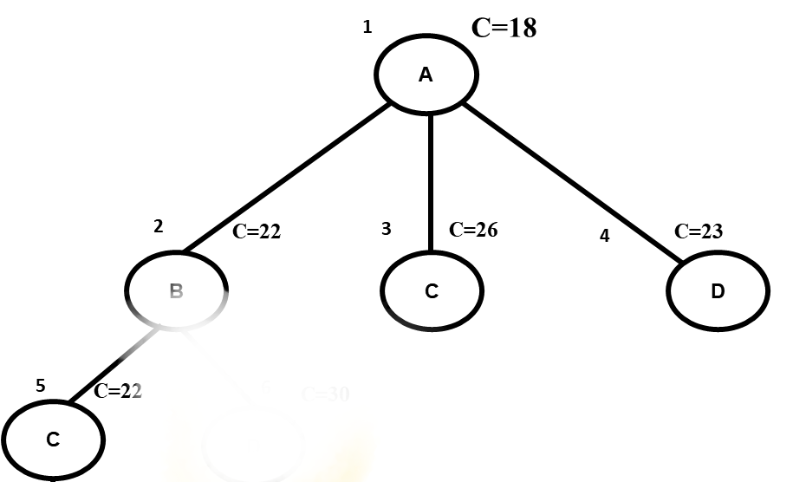
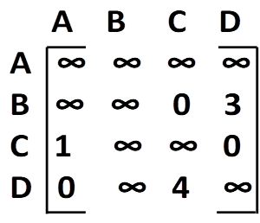
Travelling sales person problem
Step 5: For finding the cost of C from B, Make B’s Row , C’s Column and [C,A] as ∞ from 2, and check for the Reduced Matrix.
B[ ]=
It is a Reduced Matrix, So for finding cost of C,
c[C] = c[B,C] + c[B] + r
= 0 + 22 + 0
= 22

Slide 23
Travelling sales person problem
Step 5: For finding the cost of D from B, Make B’s Row , D’s Column and [D,A] as ∞ from 2, and check for the Reduced Matrix.
B[ ]=
Find Reduced Matrix,
Row Reduction
1
C=18
A
2
C=22
3
C=26
4
C=23
B
C
D
5
C=22
6
C=30
C
D
For finding cost of D,
c[D] = c[B,D] + c[B] + r
= 3 + 22 + 5
=30
------------------------> 6

Slide 24
Travelling sales person problem
Now among C and D vertices, Vertex C has the minimum cost. So by applying LC bound , traverse the remaining vertices from vertex C.
1
C=18
A
2
C=22
3
C=26
4
C=23
B
C
D
5
C=22
6
C=30
C
D
7
D

Slide 25
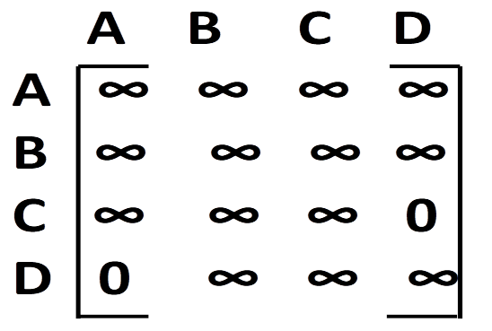
Travelling sales person problem
Step 5: For finding the cost of D from C, Make C’s Row , D’s Column and [D,A] as ∞ from 5, and check for the Reduced Matrix.
C[ ]=
1
Upper = 22
2
C=22
3
C=26
4
C=23
For finding cost of D,
c[D] = c[C,D] + c[C] + r
= 0 + 22 + 0
=22
A → B → C → D → A
5
C=22
6
C=30
C
D
7
C=22
D

Slide 26
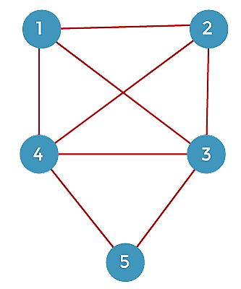
Travelling sales person problem
Example 2: Find the shortest possible tour that visits every city exactly once and returns to the starting point.
The adjacent matrix of the problem is given below:

Slide 27
Travelling sales person problem
Solution: Find the shortest possible tour that visits every city exactly once and returns to the starting point.
--------------> 2

Slide 28
Travelling sales person problem
Solution: Find the shortest possible tour that visits every city exactly once and returns to the starting point.

Slide 29
Travelling sales person problem
Solution: Find the shortest possible tour that visits every city exactly once and returns to the starting point.

Slide 30
Travelling sales person problem
Solution: Find the shortest possible tour that visits every city exactly once and returns to the starting point.

Slide 31
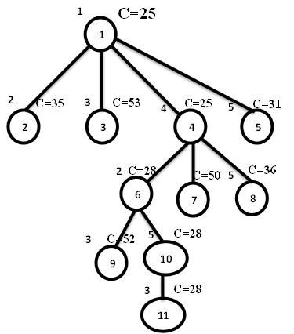
Travelling sales person problem
Solution: Find the shortest possible tour that visits every city exactly once and returns to the starting point.
Upper = 28
Shortest possible tour is
1 -> 4 -> 2 -> 5 -> 3

Slide 32
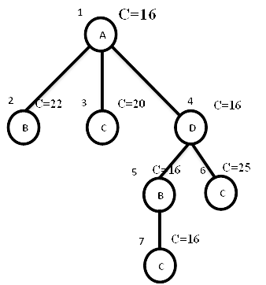
Travelling sales person problem
Example 3: Find the shortest possible tour that visits every city exactly once and returns to the starting point.
Solution:
Shortest possible tour is A -> D -> B -> C -> A
10
A
B
Upper = 16
8
5
3
2
3
6
9
7
1
8
C
D
9

Slide 33
0/1 Knapsack problem
Consider the instance:
M = 15,
n = 4,
(P1, P2, P3, P4) = (10, 10, 12, 18) and
(w1, w2, w3, w4) = ( 2, 4, 6, 9).
Solution:
Construct a state space tree
Calculate lower bound and upper bound for each node.
No fractions are allowed in calculation of upper bound
Fractions are allowed in calculation of lower bound

Slide 34
0/1 Knapsack problem
Place first item in knapsack.
Remaining weight of knapsack is 15 – 2 = 13.
Place next item w2 in knapsack and the remaining weight of knapsack is 13 – 4 = 9.
Place next item w3 in knapsack then the remaining weight of knapsack is 9 – 6 = 3. Profit = P1 + P2 + P3 = 10 + 10 + 12
So, Upper bound = 32
To calculate lower bound we can place w4 in knapsack since fractions are allowed in
calculation of lower bound.
Lower bound = 10 + 10 + 12 + (18/9 x 3) = 32 + 6 = 38
Knapsack problem is maximization problem but branch and bound technique is applicable for only minimization problems
In order to convert maximization problem into minimization problem we have to take negative sign for upper bound and lower bound.

Slide 35
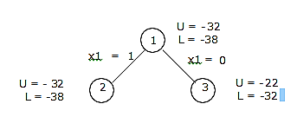
0/1 Knapsack problem
Therefore, Upper bound (U) = -32
Lower bound (L) = -38
Now we will calculate upper bound and lower bound for nodes 2, 3. For node 2, x1= 1, means we should place first item in the knapsack.
U = 10 + 10 + 12 = 32, make it as -32
L = 10 + 10 + 12 + 18 / 9 x 3 = 32 + 6 = 38, make it as -38
For node 3, x1 = 0, means we should not place first item in the knapsack.
U = 10 + 12 = 22, make it as -22
L = 10 + 12 + 18 / 9 x 5 = 10 + 12 + 10 = 32, make it as -32
Next, we will calculate difference of upper bound and lower bound for nodes 2, 3
For node 2, U – L = -32 + 38 = 6
For node 3, U – L = -22 + 32 = 10

Slide 36
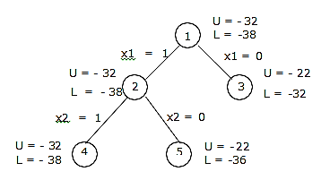
0/1 Knapsack problem
Choose node 2, since it has minimum difference value of 6.
Now we will calculate lower bound and upper bound of node 4 and 5. Calculate difference of lower and upper bound of nodes 4 and 5.
For node 4, U – L = -32 + 38 = 6
For node 5, U – L = -22 + 36 = 14

Slide 37
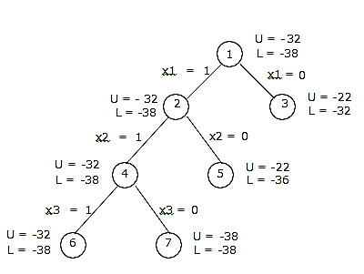
0/1 Knapsack problem
Choose node 4, since it has minimum difference value of 6.
Now we will calculate lower bound and upper bound of node 8 and 9. Calculate difference of lower and upper bound of nodes 8 and 9.
For node 6, U – L = -32 + 38 = 6
For node 7, U – L = -38 + 38 = 0

Slide 38
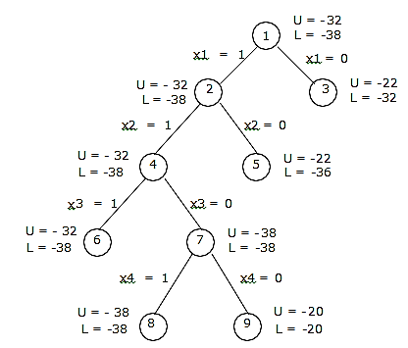
0/1 Knapsack problem
Choose node 7, since it is minimum difference value of 0.
Now we will calculate lower bound and upper bound of node 4 and 5. Calculate difference of lower and upper bound of nodes 4 and 5.
For node 8, U – L = -38 + 38 = 0
For node 9, U – L = -20 + 20 = 0

Slide 39
0/1 Knapsack problem
Here the difference is same, so compare upper bounds of nodes 8 and 9. Discard the node, which has maximum upper bound. Choose node 8, discard node 9 since, it has maximum upper bound.
Consider the path from 1 -> 2 -> 4 -> 7 -> 8
X1 = 1
X2 = 1
X3 = 0
X4 = 1
The solution for 0/1 Knapsack problem is (x1, x2, x3, x4) = (1, 1, 0, 1)
Maximum profit is: ∑Pi xi = 10 x 1 + 10 x 1 + 12 x 0 + 18 x 1
= 10 + 10 + 18 = 38.

Slide 40
P and NP class
Class P:
P: The P in the P class stands for Polynomial Time. It is the collection of decision problems that are solvable in O(p(n)) time, where p(n) is a polynomial of problem’s input size n
Examples:
Searching – Linear search & Binary search
Sorting – Insertion sort, Merge sort, Quick sort
Matrix chain multiplication
Element uniqueness
Graph connectivity

Slide 41
P and NP class
Class NP:
NP (nondeterministic polynomial): class of decision problems whose proposed solutions can be verified in polynomial time & solvable by a nondeterministic polynomial algorithm (in exponential time)
Examples:
Travelling Salesperson
0/1 Knapsack
Sum of subsets
Hamiltonian cycle
Graph coloring

Slide 42
Deterministic and Non-deterministic Algorithms
Deterministic:
The algorithm in which every operation is uniquely defined.
Non-Deterministic:
The algorithm in which the operations are not uniquely defined but are limited to specific set of possibilities for every operation.
Example:
Algorithm search(A,n,key)
{ j=choice();
if(key=A[j])
{ write(j);
success(); }
write(0);
failure(); }

Slide 43
Deterministic and Non-deterministic Algorithms
Satisfiability:
The satisfiability is a boolean formula that can be constructed using the following literals and operations.
A literal is either a variable or its negation of the variable.
The literals are connected with operators ˅, ˄, ⇒ , ⇔
Parenthesis
It is to determine whether a Boolean formula is true for some assignment of truth values to the variables.
Reducability:
A problem Q1 can be reduced to Q2 if any instance of Q1 can be easily rephrased as an instance of Q2.
If the solution to the problem Q2 provides a solution to the problem Q1, then these are said to be reducable problems.

Slide 44
NP-Hard and NP-Complete Problems
NP-Hard and NP-Complete Problem:
The nondeterministic polynomial time problems can be classified into two classes. They are
1. NP Hard and
2. NP Complete
NP-Hard:
A problem L is NP-Hard iff satisfiability reduces to L i.e., any nondeterministic polynomial time problem is satisfiable and reducable then the problem is said to be NP-Hard.
Example: Halting Problem, Flow shop scheduling problem

Slide 45
NP-Hard and NP-Complete Problems
NP-Complete:
A problem L is NP-Complete iff L is NP-Hard and L belongs to NP (nondeterministic polynomial).
If an NP-hard problem can be solved in polynomial time, then all NP- complete problems can be solved in polynomial time.
All NP-Complete problems are NP-hard, but some NP- hard problems are not known to be NP- Complete.
Example:
Knapsack decision problem can be reduced to knapsack optimization problem

Slide 46
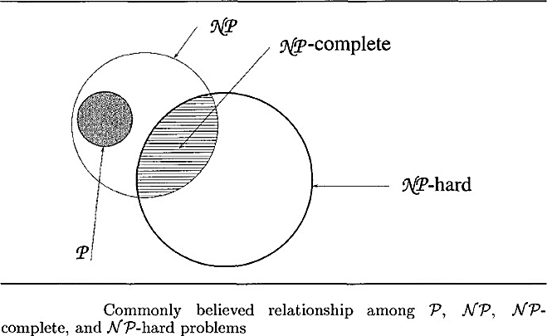
Relationship between P,NP,NP-hard, NP-Complete
Let P, NP, NP-hard, NP-Complete are the sets of all possible decision problems that are solvable in polynomial time by using deterministic algorithms, non-deterministic algorithms, NP-Hard and NP-complete respectively.

Slide 47
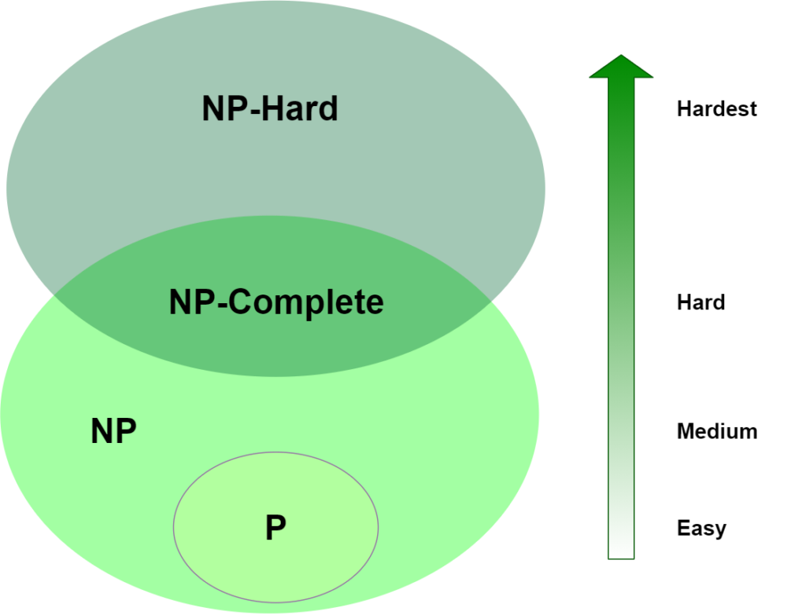
Relationship between P,NP,NP-hard, NP-Complete

